Slide 1
Building Milk Adulteration Detection Model
Anshu Anamika

Slide 2
Milk Adulteration
Despite being the world’s largest milk producer, milk adulteration is a serious problem in India due to a combination of economic, regulatory, and supply chain issues.
Milk adulteration is the act of adding foreign, inferior, harmful, or unnecessary substances to milk to increase its quantity, shelf life, or appearance, often for economic gain.
Over 60% to 70% of milk in India (only 10- 15% in UK) is handled by the unorganised sector.
Lack of traceability makes it hard to identify who adulterated it.
Limited field testing of milk
Weak penalty enforcement
Supply chain issue- No cold chain or proper storage
Unregulated pricing and payment to farmers
Thus milk vendors tempt to milk adulteration to gain maximum profit, but this process lowers the nutritional value of milk and can pose serious health risks to consumers.

Slide 3
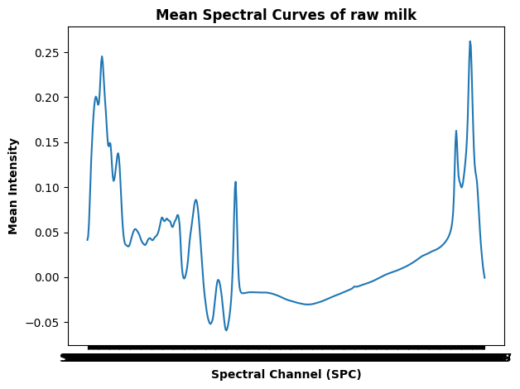
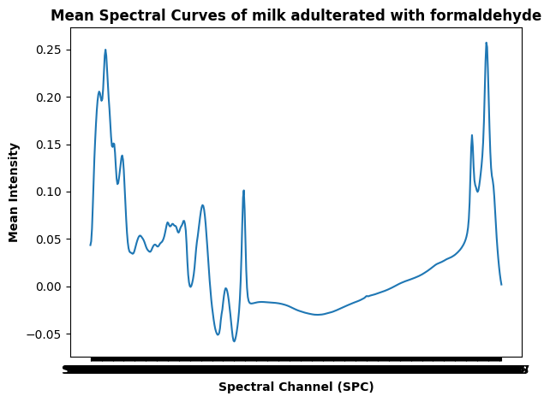
Milk adulteration detection methods limitations
Adulteration detection methods
Chemical testing- limitations: slow, human error, not scalable, not suitable for all adulterants
Spectroscopic analysis- limitations: Requires expert interpretation, Experts need to manually inspect each spectrum, compare peaks, and interpret patterns.
small spectral changes that are hard to detect visually.
My objective:
Build a classification machine learning model to detect adulteration
ML models learn tiny, complex patterns from large datasets that humans might overlook.
machine learning adds speed (real time), accuracy, automation, and scalability, which are crucial in real-world dairy or food labs.

Slide 4
Data set
Downloaded from kaggle
row: 969, column: 536
Columns : 'Ingredient', 'IsRawMilk', 'Cells', 'QValue', 'Fat', 'Protein', 'Lactose', 'Solids', 'FFA', 'Citrate', 'FrzPoint', 'SNF', 'MUN', 'Casein', 'SPC 1002’, ‘SPC 1006’- - - - - - - - - -‘SPC 2997’
No null/missing values

Slide 5
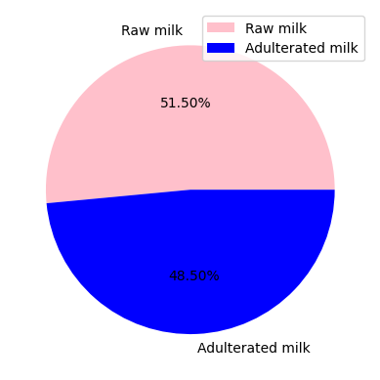
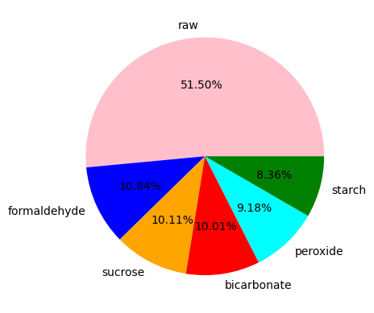
How balance is the data set?

Slide 6
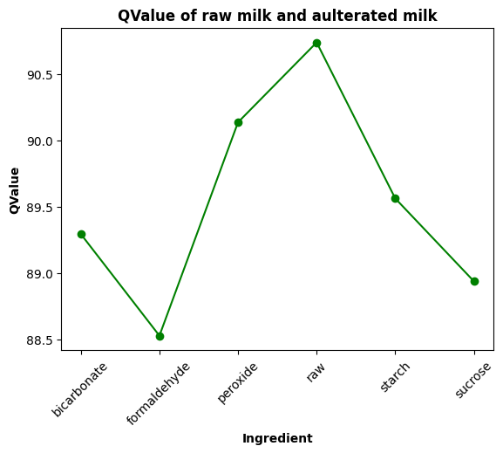
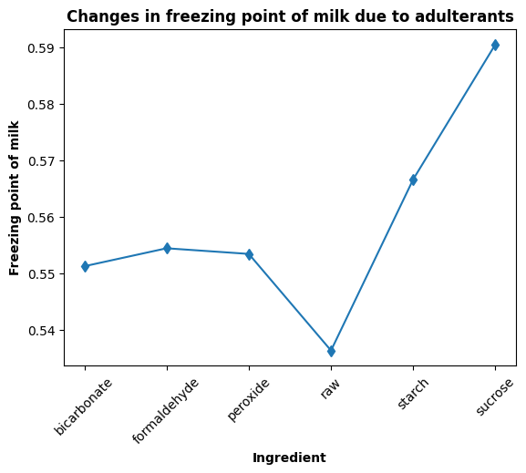

Slide 7
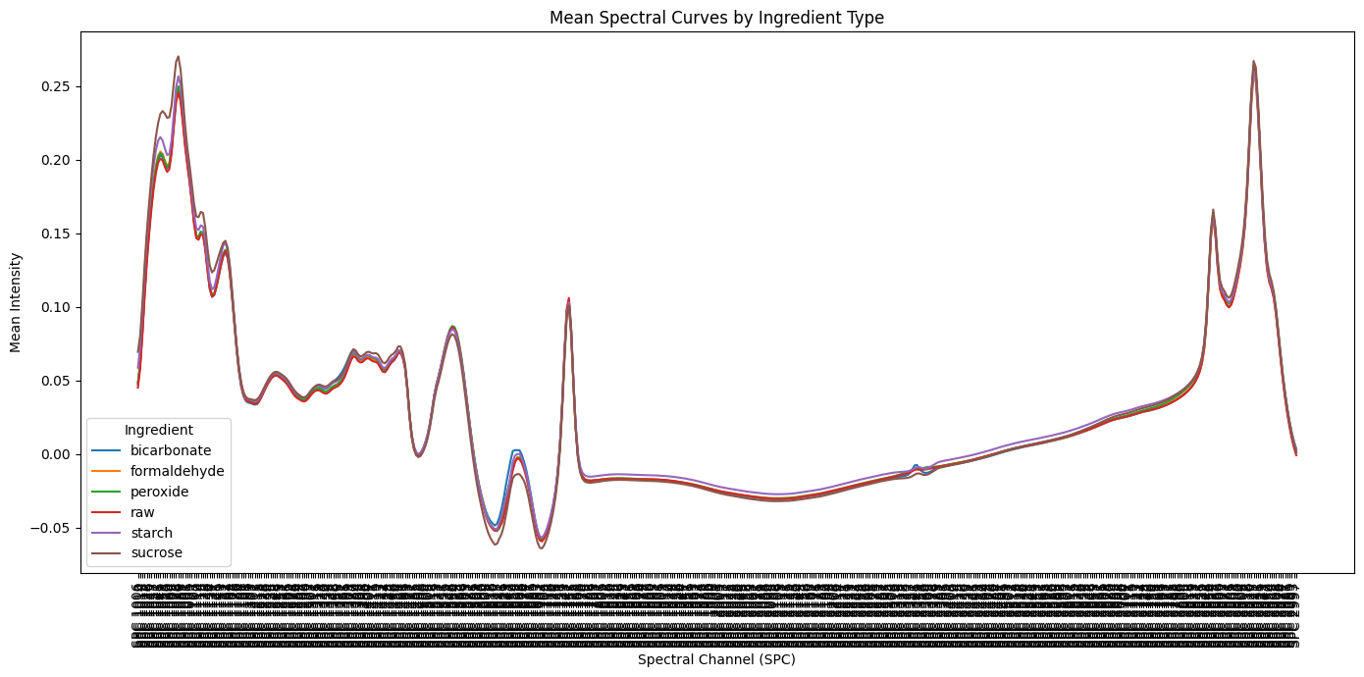

Slide 8
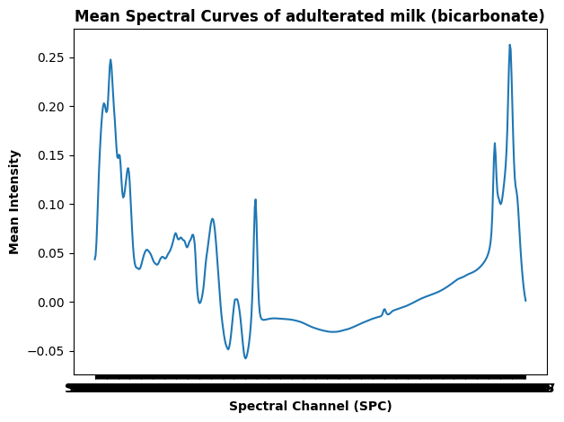

Slide 9
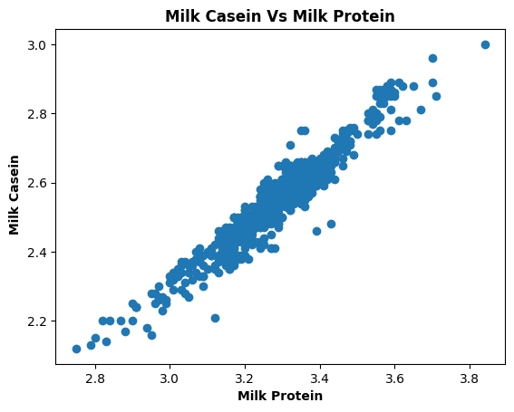

Slide 10
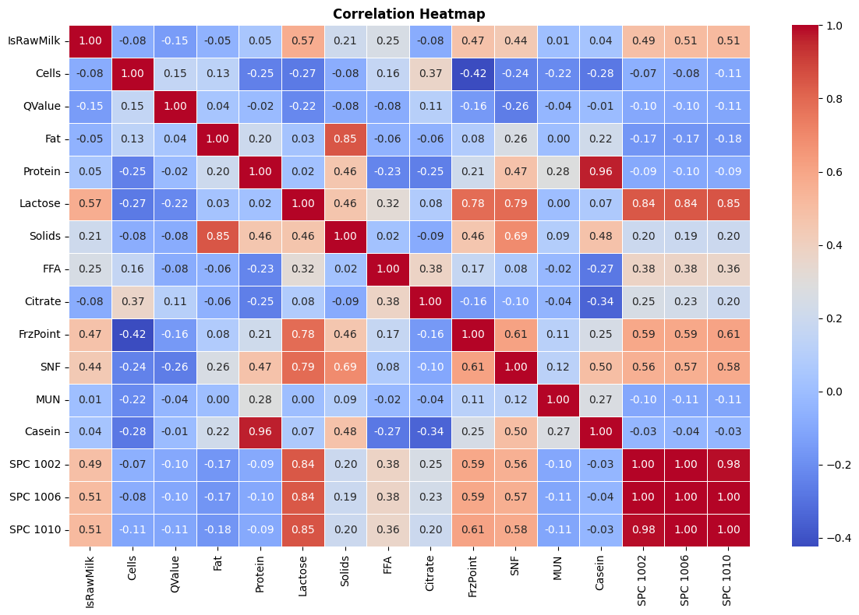

Slide 11
Data Preprocessing
Feature selection :
Trial 1 : Selected all the spectroscopic results and only features which show higher correlation with target column
Trial 2 : Selected all 518 spectroscopic results only
IsRawMilk – Target column- changed the categories from yes, no to 0 , 1
Scaling: Robustscaler
PCA – Reduced 521 features into 14 principal components- Trial 1

Slide 12
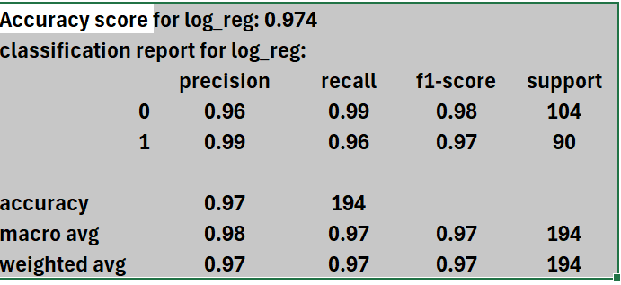
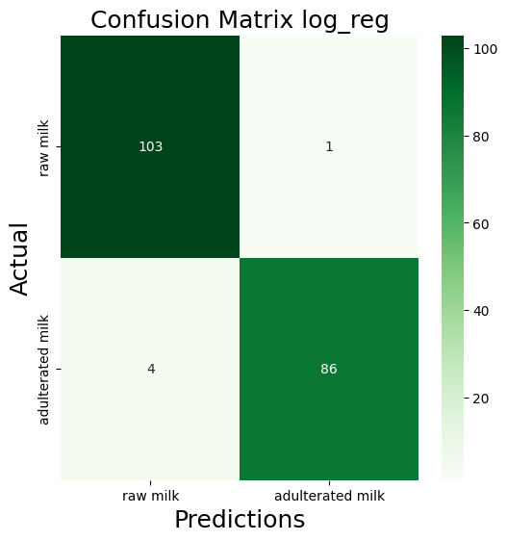
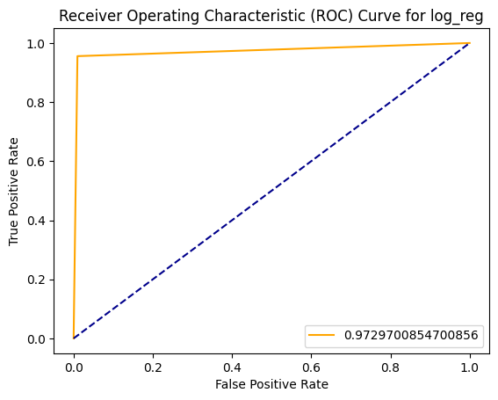

Slide 13
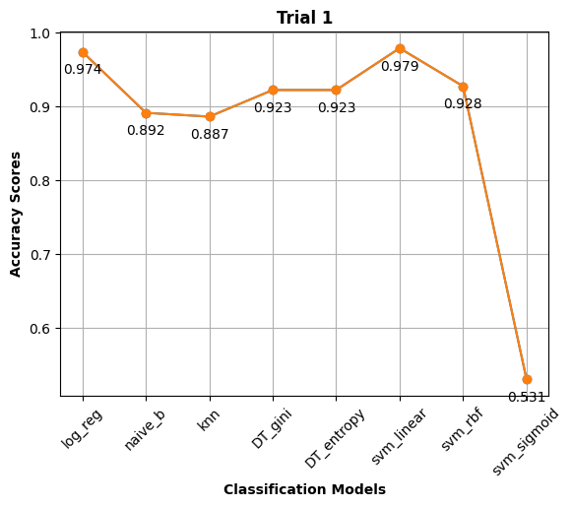

Slide 14
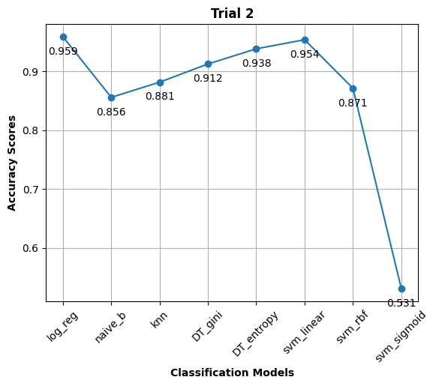
Comparison between Trials

Slide 15
Deployment of the model
Used streamlit to deploy it as a web application
518 features recorded in a csv file needs to be uploaded
User can preview their data
Option for user can download the result/prediction

Slide 16
Conclusion
Strengths:
Model performing well to predict whether milk is adulterated or not
Providing solutions : speed (real time), accuracy, automation, and scalability
Improvements:
Trained on only 969 samples of milk – can be trained on larger data to make it more robust
Trained on only 5 different types of adulterants-need to be trained on other types of adulterants-to make it more efficient for real world application

